Slide 1
Joins
No man is an island entire of itself

Slide 2
Examples for this lecture
Probably not surprising, JOIN involves more than one table.
We will stick with our patient table and add a diagnosis table.
patient diagnosis
patientId diagnosisId
firstName patientId
lastName diagnosisName
age
patients are John Smith (id 1) and Jane Doe (id 2)
diagnoses are John has a cold and Jane is pregnant.

Slide 3
Join Definition
Joining two (or more) tables is the process of returning the unique tuples (rows) that make up all of the involved tables matching the join criteria.
Intuitively, in words, describe what you think “we want” from joining patient and diagnosis.

Slide 4
Cross Join or Cross Product or Cartesian Product
A cross join matches EVERY record from each table with EVERY OTHER RECORD.
Cross join would result in 4 rows:
John Smith, cold
John Smith, pregnant
Jane Doe, cold
Jane Doe, pregnant
In relational algebra: patient × diagnosis
In SQL: SELECT * FROM patient CROSS JOIN diagnosis

Slide 5
Why would you want to do that?
Honestly, you probably never would.
The (contrived) example:
I have 4 card suites (hearts, spades, clubs, diamonds)
I have 13 card ranks (2-10, Jack, Queen, King, Ace)
I want the database to generate all 52 cards.

Slide 6
Natural or Equijoin
Natural join matches the two tables/relations (call them A and B) based on column/attribute names. Start by comparing the columns/attributes of A and B. Where the columns/attributes have the same name you add them to the join criteria.
With patient and diagnosis, they have only patientId in common, so the result is what we would expect.
In relational algebra: patient ⋈diagnosis
In SQL: SELECT * FROM patient NATURAL JOIN diagnosis
SQL SERVER does not support this (it’s an optional part of the standard)

Slide 7
Why Natural Join is BAD
Explicit > Implicit
Imagine, for a moment, that we have a need to change our sample schema – our new CIO wants “createdDate” on every record.
How does that impact our natural joins?

Slide 8
Inner Join
Inner join, unlike Cross and Natural, requires you to define conditions.
In an Inner Join, like Natural Join, two records match when the join condition is completely satisfied.
In relational algebra:
patient ⋈_{diagnosisId=diagnosisId} diagnosis

Slide 9
Inner Join
There are two notations in SQL – old (deprecated) and new:
Old: SELECT * FROM patient, diagnosis
WHERE patient.patientId = diagnosis.patientId
New: SELECT * FROM patient INNER JOIN diagnosis
ON patient.patientId = diagnosis.patientId
Stylistically, the new format allows you to have a WHERE clause that is distinct from the join condition. Functionally, they are the same.

Slide 10
Maybe we have data?
How do we deal with the situation where we want to see the data from a table and, if existing, the data from another?
For example – how can I see a list of all of the patients and their diagnosis, if they have one?

Slide 11
Outer Join
Comes in three varieties: LEFT, RIGHT and FULL
Direction indicates “the table that will have all of its rows in the result”
In relational algebra:
patient ⟕_{patientId=patientId}diagnosis
patient ⟖_{patientId=patientId}diagnosis
patient ⟗_{patientId=patientId}diagnosis

Slide 12
Outer Join (SQL)
The new syntax:
SELECT * FROM patient LEFT OUTER JOIN diagnosis
ON patient.patientId = diagnosis.patientId
SELECT * FROM patient RIGHT OUTER JOIN diagnosis
ON patient.patientId = diagnosis.patientId
SELECT * FROM patient FULL OUTER JOIN diagnosis
ON patient.patientId = diagnosis.patientId

Slide 13
Outer Join (SQL)
Unfortunate:
The keyword “OUTER” is optional. You may hear people talk about LEFT JOIN.
The old syntax was never standard, you may see:
SELECT * FROM t1, t2 WHERE t1.col = t2.col(+)
SELECT * FROM t1, t2 WHERE t1.col *= t2.col
SELECT * FROM t1, OUTER t2 WHERE t1.col = t2.col
Don’t ever use these – they are (obviously) not portable.

Slide 14
Outer Join Observation
There is NO difference between these:
SELECT * FROM patient LEFT OUTER JOIN diagnosis
ON patient.patientId = diagnosis.patientId
SELECT * FROM diagnosis RIGHT OUTER JOIN patient
ON patient.patientId = diagnosis.patientId

Slide 15
Renaming Tables
In the same way that you can rename columns for the duration of the query, you can also rename tables for the duration of the query:
SELECT p.firstName FROM patient p

Slide 16
Self Join
Not a different type of join, more of a “I didn’t think you could do that”
If you have a doctor(doctorId, name, supervisingDoctorId) and you want to do a query to show all doctors and their supervisors:
SELECT d.name, s.name
FROM doctor d LEFT OUTER JOIN doctor s
ON d.supervisingDoctorId = s.doctorId
Why did I use LEFT OUTER JOIN?

Slide 17
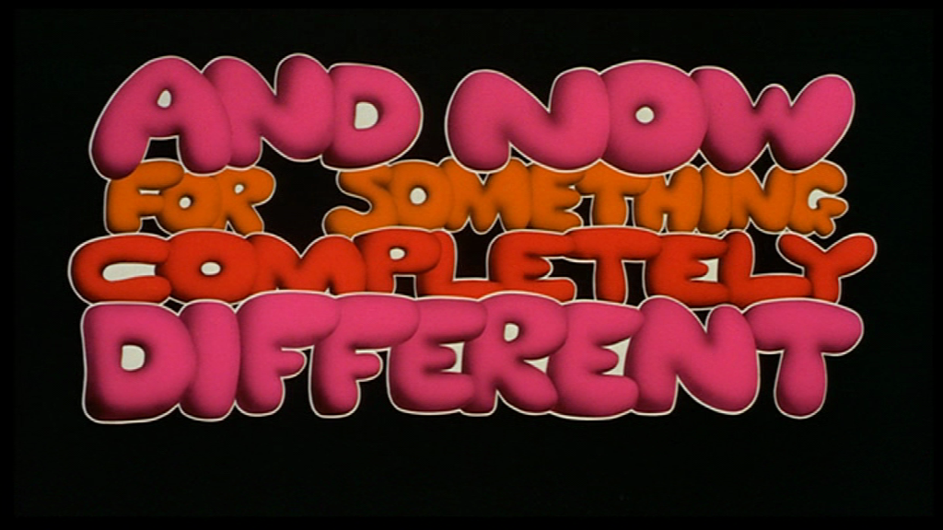

Slide 18
Set Operators
Joins work on tables by concatenating t1 to t2.
Set operators work on tables (or table subsets) where the columns match by number and type.
For these examples, remember that we have:
patient (firstName, lastName,…) and doctor(name)

Slide 19
Find All Doctors and Patients In the Hospital
Doctor
Patient
In relational algebra:
doctor ∪ π _{firstName+lastName}(patient)
SELECT name FROM doctor
UNION
SELECT firstName + lastName FROM patient

Slide 20
UNION
In both relational algebra and SQL, unions will return the unique rows.
SQL has the option to turn that off:
SELECT name FROM doctor
UNION ALL
SELECT firstName + lastName FROM patient
Why would I want both options available?

Slide 21
Find all Doctors who are also Patients
Doctor
Patient
In relational algebra, intersection:
doctor ∩ π _{firstName+lastName}(patient)
In SQL:
SELECT name FROM doctor
INTERSECT
SELECT firstName + lastName FROM patient

Slide 22
Find all doctors who are NOT patients
Doctor
Patient
In relational algebra, difference:
doctor - π _{firstName+lastName}(patient)
In SQL:
SELECT name FROM doctor
EXCEPT
SELECT firstName + lastName FROM patient

Slide 23


Slide 24
Dumbest way first…
for (var a in A)
for (var b in B)
if (match(a,b))
output(a + b)
match == whatever join criteria were specified
O(AxB) time. Simple to write.

Slide 25
What if the tables were sorted?
If the tables were sorted by the join condition(s), we could do a merge sort “two finger” algorithm.
How can we get a sort?
Clustered Index
Non-Clustered Index
Run a sort just for this query
Exercise – what is the big-O for sorts? How long does it take to make this better than naïve approach?

Slide 26
Hash join
What if we create a hash table (Java map) of the smaller table, keyed on the join condition attributes?
Then we could walk (iterate over) the larger table and query the smaller table via the map.

